Slide 1
Review
Pheochromocytoma in NF-1

Slide 2
Neurofibromatosis type 1 and pheochromocytoma
Pheochromocytoma occurs in approximately 1% of pts with NF-1¹
Accordingly, germ-line mutations in the NF1 gene — localized to chromosome 17q11.2 — are assumed to be one of the heritable causes of pheochromocytoma¹
Malignant pheochromocytoma were identified about 11.5% of all pheochromocytoma in NF-1 patients²
  Liver 30%
  Lung 30%
  Bone 25%
  Lymph node 10%
  Peritoneal carcinomatosis 5%
¹NEJM 2006;354(25):2729-2731.
²The Journal of Urology 1999;162:1582-1586.
Notes:
Incidence pheo 0.1-5.7% in NF1 by clinical, 3.3-13% from autopsy (Urology 1999)
NF1 gene เป็น tumor suppressor gene

Slide 3
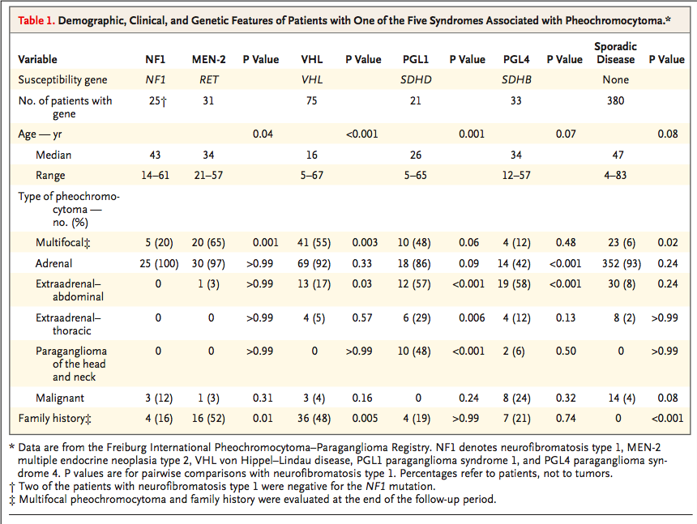
NEJM 2006;354(25):2729-2731.
Notes:
Registry from 20 centers in Germany and European country (July 1,2005) include 565 patients with adrenal, extraadrenal-abdominal, and extraadrenal-thoracic pheo

Slide 4
Composite pheochromocytoma
Composite pheochromocytoma(CP) is a very rare tumor that accounts for only 3% of both adrenal and extra-adrenal pheochromocytoma
CP combines features of pheochromocytoma or paraganglioma with neural components
  Ganglioneuroma
  Ganglioneuroblastoma
  Neuroblastoma
  Peripheral nerve sheath tumor
  Neuroendocrine carcinoma
The embryologic origin of those origin from neural crest
Int J Clin Exp Med 2017;10(3):4740-4747.
Notes:
มี report CP ประมาณ 50 เคส ถึงปี 2017 (ganglioneuroma เจอบ่อยสุด)

Slide 5
VIP-secreting pheochromocytoma
Watery diarrhea, hypokalemia and achlorhydria(WDHA) syndrome is caused by VIP-producing tumors
  VIP stimulates intestinal electrolyte and fluid secretion by activating adenylate cyclase and cyclic AMP in intestinal cells
Most VIPomas arise in the pancreas, as many as 10% occur in extra-pancreatic sites, usually involving the sympathetic chain or adrenal medulla
Journal of Internal Medicine 1999;246:231-234.
Jpn J Clin Oncol 2005;35(9):559-563.
BMC Cancer 2004;14:1-5.

Slide 6
VIP-secreting pheochromocytoma
The diagnosis is established by a elevated serum vasoactive intestinal polypeptide (VIP) concentration
Base on histology, there are two subtypes for these
VIP-secreting pheochromocytomas
  Composite form (mixed pheochromocytoma and ganglioneuroma)
  Classic form (pheochromocytoma only)
BMC Cancer 2014;14:1-5.

Slide 7
VIP-secreting pheochromocytoma
However, many patients did not show typical symptoms of pheochromocytoma such as hypertension
  VIP acts as vasodilator (splanchnic and peripheral vascular beds)
  Secretory diarrhea, resulting in hypovolemia
The symptom due to excessive VIP production subside after successful removal of the tumor
VIP-secreting pheochromocytoma had a relatively poor response to octreotide because the lack of somatostatin receptors in these tumor cells
Journal of Internal Medicine 1999;246:231-234.
Jpn J Clin Oncol 2005;35(9):559-563.
BMC Cancer 2014;14:1-5.

Slide 8
Pheochromocytoma crisis
Timing for surgery
  No Crisis
    Alpha-blocker at least 7-14 day before surgery
  Pheochromocytoma crisis
    Medical stabilization
      Alpha-blocker titration
    Elective or urgency surgery
      Emergency resection of pheochromocytoma is associated with high surgical morbidity and mortality and should be avoided
J Clin Endocrinol Metab, February 2013, 98(2):581–591

Slide 9
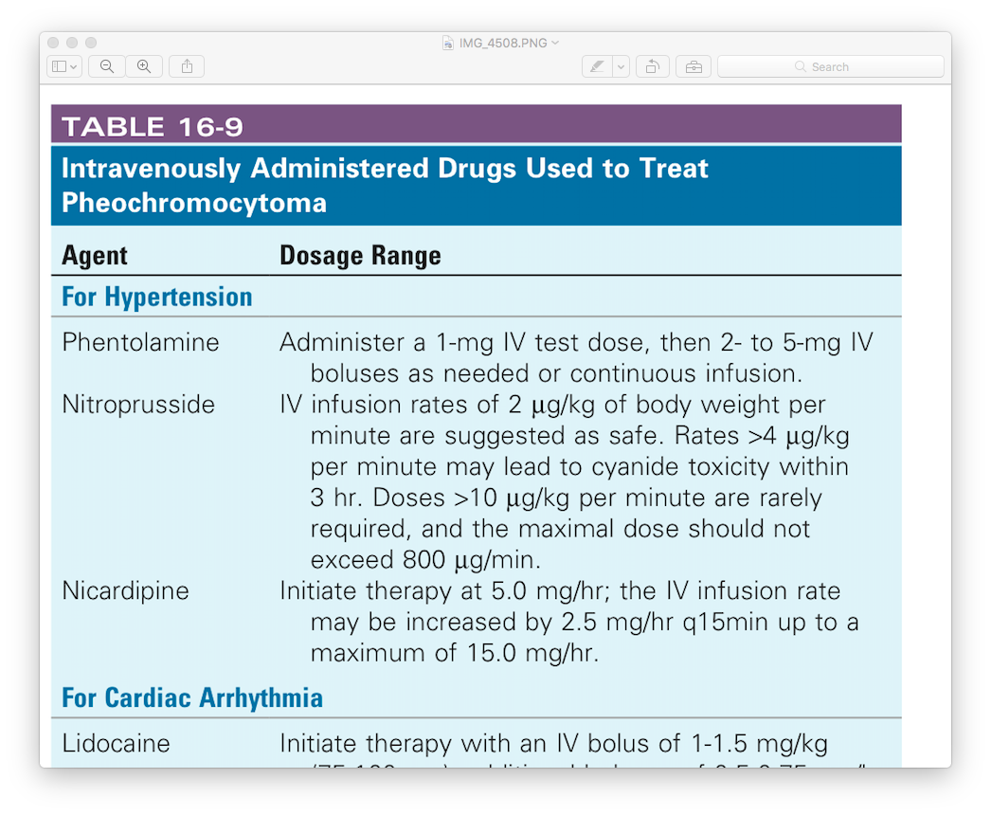
Pheochromocytoma crisis
Acute hypertensive crisis should be treated with intravenously administered of
Williams Textbook of Endocrinology 13th edition 2016.

