Slide 1
Interhospital Conference
Squamous cell carcinoma of thyroid gland

Slide 2
Review

Slide 3
Squamous cell carcinoma of thyroid
Definition
“Squamous cell carcinoma of thyroid” (SCC of thyroid) should be composed entirely of tumor cells with squamous differentiation. (incidence < 1% of thyroid malignancies)
Differential diagnosis
SCC metastasis to the thyroid
Other types of thyroid carcinoma that may resemble
squamous carcinoma
Squamous cell carcinoma of the thyroid gland: primary or secondary disease? J Laryngol Otol. 2011;125(1):3-9

Slide 4
Squamous cell carcinoma of thyroid
Pathophysiology -> Unknown
Metaplasia theory
  Squamous metaplasia superimposing on an underlying thyroid pathology
De-differentiation theory
    Squamous differentiation in papillary carcinoma or anaplastic carcinoma
Embryonic-nest theory
    Squamous cell cancer develops in remnants of the ultimobranchial body or thyroglossal duct
Primary squamous cell carcinoma of the thyroid: report of ten cases. Thyroid. 2006;16(1):89-93
Primary squamous cell carcinoma of the thyroid gland. J Surg Case Rep. 2014;2014(12)

Slide 5
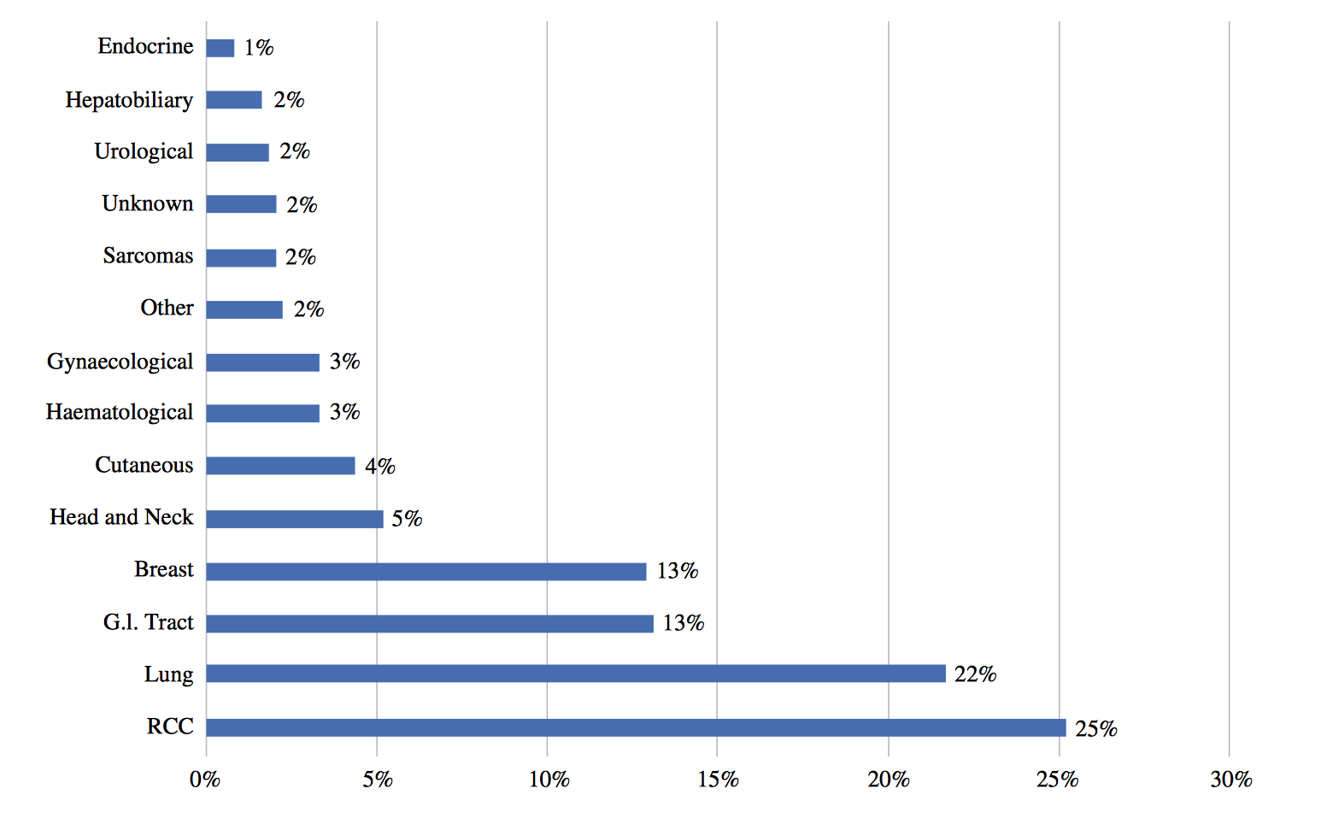
Metastatic tumors to thyroid
Secondary involvement of the thyroid gland
Adjacent structures
Distant structures
Squamous cell carcinoma of the thyroid gland: primary or secondary disease? J Laryngol Otol. 2011;125(1):3-9
Figure from: Metastasis to the Thyroid Gland: A Critical Review. Ann Surg Oncol. 2017;24(6):1533-9

Slide 6
Metastatic tumors to thyroid
Secondary involvement of the thyroid gland
Adjacent structures: base of tongue, larynx, pharynx,
upper esophagus
Distant structures
Squamous cell carcinoma of the thyroid gland: primary or secondary disease? J Laryngol Otol. 2011;125(1):3-9
Figure from: Metastasis to the Thyroid Gland: A Critical Review. Ann Surg Oncol. 2017;24(6):1533-9

Slide 7
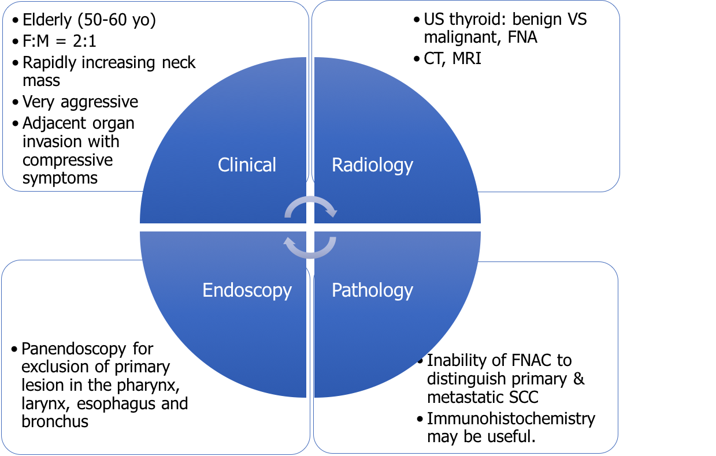

Diagnosis for SCC of thyroid
: tumor extension
: find out metastatic
SCC to thyroid
Must always exclude secondary involvement of the thyroid.
Strongly positive CK19
Negative CK1, 4, 10/13, 20
Squamous cell carcinoma of the thyroid gland: primary or secondary disease? J Laryngol Otol. 2011;125(1):3-9
Primary squamous cell carcinomas in the thyroid gland: an individual participant data meta-analysis. Cancer Med. 2014;3(5):1396-403

Slide 8
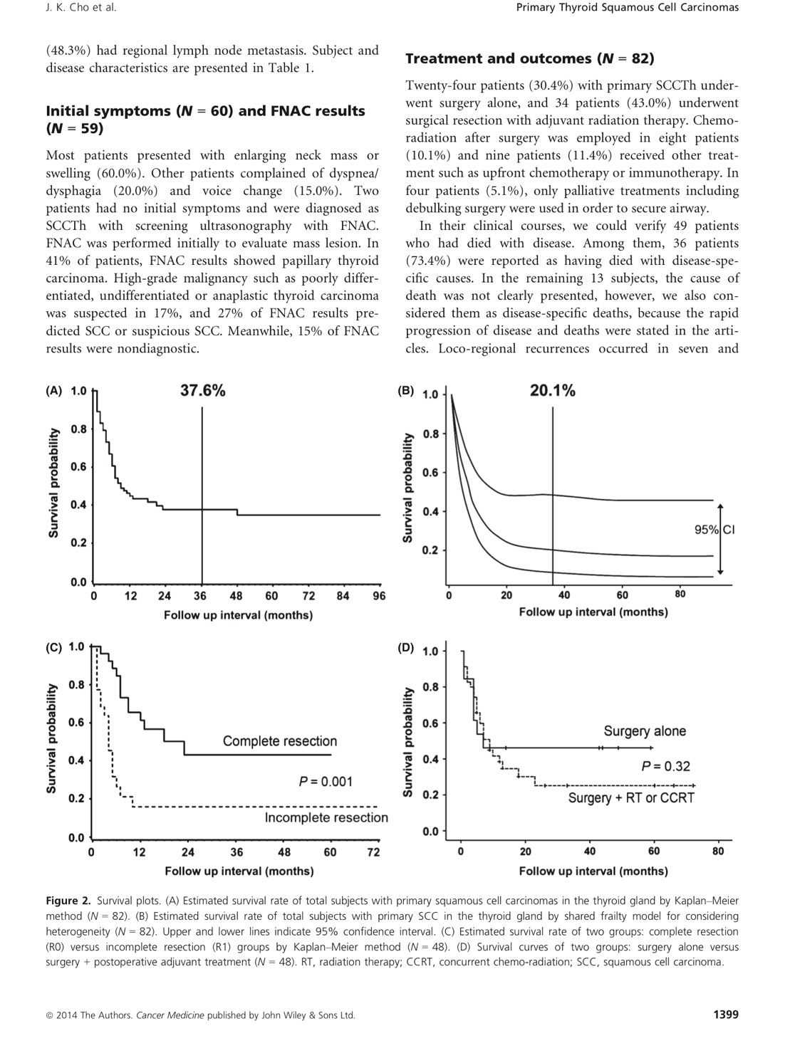
Squamous cell carcinoma of thyroid
Prognosis and management
Median survival was 9 months. (95% CI, 6-23)
Primary squamous cell carcinomas in the thyroid gland: an individual participant data meta-analysis. Cancer Med. 2014;3(5):1396-403

Slide 9
Thank You

