Slide 1
Adrenal Histoplasmosis

Slide 2
Adrenal Histoplasmosis
Organism: Histoplasma capsulatum
Most common fungal infection involving adrenal glands
More prevalent in immunocompromised patients
  AIDS
  Transplant recipients
  Hematologic malignancies
  Patients on corticosteroids
0.65% of systemic mycosis among non-AIDS patients
Larbcharoensub N, et al. Southeast Asian J Trop Med Public Health. 2011;42(4):920-5.

Slide 3
Adrenal Histoplasmosis
Clinical spectrum of histoplasmosis
  Pulmonary histoplasmosis (acute, chronic)
  Progressive disseminated histoplasmosis
    Most patients experience asymptomatic hematogenous dissemination via parasitized macrophages.
    Reactivation of infection years later is possible
    Affect almost all organ systems
Gajendra S, et al. Turk patoloji dergisi. 2016;32(2):105-11.
Kauffman CA. Clinical microbiology reviews. 2007;20(1):115-32.

Slide 4
Adrenal Histoplasmosis
More common in male
Isolated adrenal involvement is rare.
Usually involving bilateral adrenal glands
May occur during active course of dissemination or evolve many years after the disease become inactive.
Gajendra S, et al. Turk patoloji dergisi. 2016;32(2):105-11.

Slide 5
Adrenal Histoplasmosis
Clinical manifestations
Asymptomatic bilateral (or unilateral) adrenal enlargement
Chronic fatigue, anorexia, weight loss, fever
Primary adrenal insufficiency (5-71%)
  Malaise, nausea, vomiting, orthostatic hypotension
  Hyponatremia, hyperkalemia
Hepatosplenomegaly, lymphadenopathy
Mucous membrane ulcers, skin ulcers, nodules, molluscum like papules
Pallor, petechiae
Duration of presenting symptoms: 1-6 months
Gajendra S, et al. Turk patoloji dergisi. 2016;32(2):105-11.
Kauffman CA. Clinical microbiology reviews. 2007;20(1):115-32.
Larbcharoensub N, et al. Southeast Asian J Trop Med Public Health. 2011;42(4):920-5.

Slide 6
Adrenal Histoplasmosis
Imaging
Ultrasonography
  Uniformly hypoechoic to heterogenous echopattern with preservation of normal adrenal gland outlines
Computed tomography (CT)
  Adrenal gland:
    Bilateral symmetrical adrenal enlargement
    Low-density areas of necrosis and hemorrhage
    Faint or dense calcification
  Liver: mild to moderate hepatomegaly
  Spleen: splenomegaly with focal hypodense lesion
  Lymph nodes: abdominal lymphadenopathy
Gajendra S, et al. Turk patoloji dergisi. 2016;32(2):105-11.

Slide 7
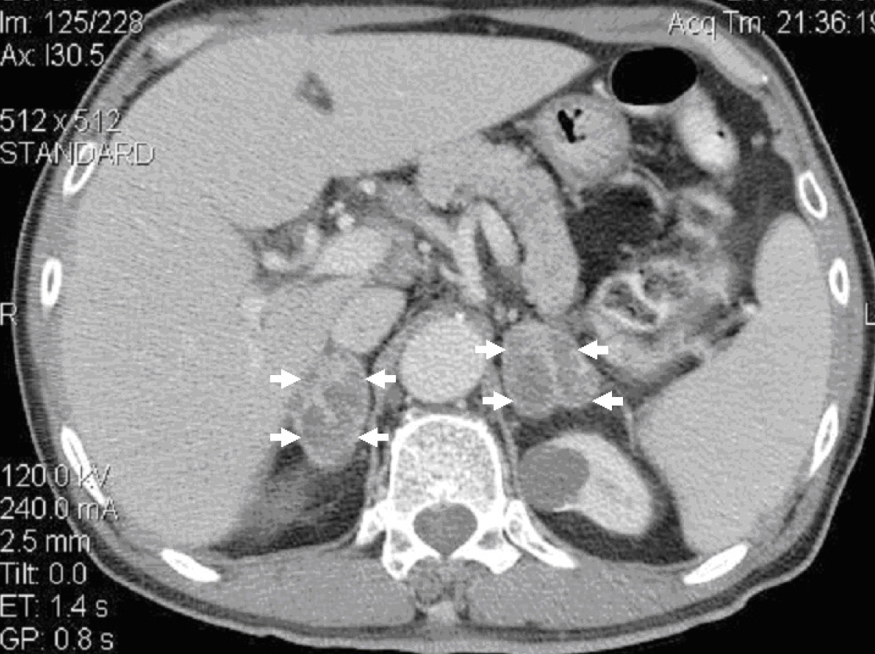
Adrenal Histoplasmosis
Imaging: computed tomography (CT)
Larbcharoensub N, et al. Southeast Asian J Trop Med Public Health. 2011;42(4):920-5.

Slide 8
Adrenal Histoplasmosis
Differential diagnosis of CT findings
  Adrenal infections
    Tuberculosis
    Aspergillosis
    Cryptococcosis
    Blastomycosis
    Penicillosis
  Adrenal lymphoma
  Adrenal metastasis
Gajendra S, et al. Turk patoloji dergisi. 2016;32(2):105-11.
Larbcharoensub N, et al. Southeast Asian J Trop Med Public Health. 2011;42(4):920-5.

Slide 9
Adrenal Histoplasmosis
Diagnosis
  Other laboratory tests
    Serology
    Complement fixation
    Precipitation test
    Latex particle agglutination test
    Aga-gel double immunodiffusion test
    Radioimmunoassay
Larbcharoensub N, et al. Southeast Asian J Trop Med Public Health. 2011;42(4):920-5.
Notes:
Left – Giemsa, Rt- GMS

Slide 10
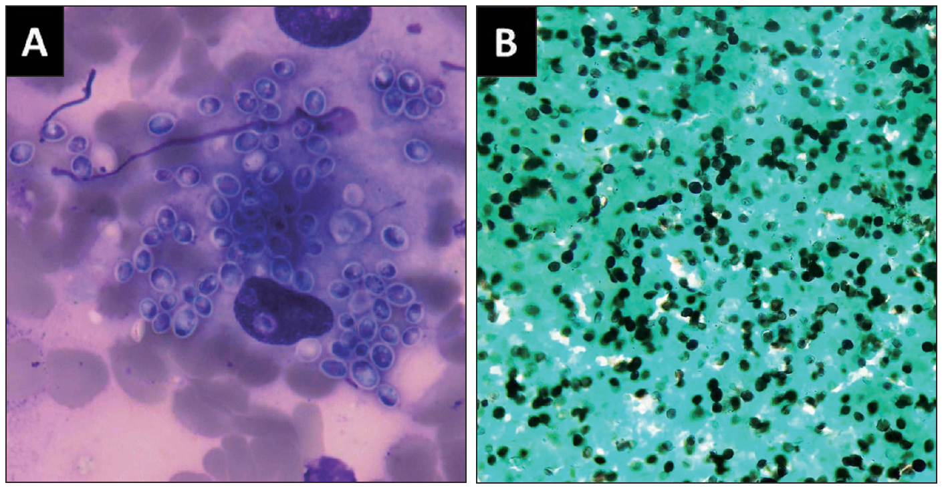
Adrenal Histoplasmosis
Diagnosis
  Tissue culture: gold standard
  Histopathology: FNAB
    Fungal yeasts: uninucleate hyaline spherules or ovules with a single bud attached by a narrow base, often seen in clusters (PAS and GMS stain)
    Localized mononuclear cells infiltrating developing granulomata with multinucleated giant cells
Gajendra S, et al. Turk patoloji dergisi. 2016;32(2):105-11.
Notes:
Left – Giemsa, Rt- GMS

Slide 11
Adrenal Histoplasmosis
Treatment: IDSA guideline 2007
Progressive disseminated histoplasmosis
Severity | Treatment
Moderately severe to severe | Liposomal Amphotericin B (3.0 mg/kg daily) or Amphotericin B lipid complex (5.0 mg/kg daily) or Deoxycholate amphotericin B (0.7–1.0 mg/kg daily) for 1–2 weeks followed by Itraconazole 200 mg twice daily for at least 12 months
Mild to moderate | Itraconazole 200 mg twice daily for at least 12 months
Glucocorticoid (and mineralocorticoid) replacement
L Joseph Wheat, et al. Clinical Infectious Diseases 2007; 45:807–25.

Slide 12
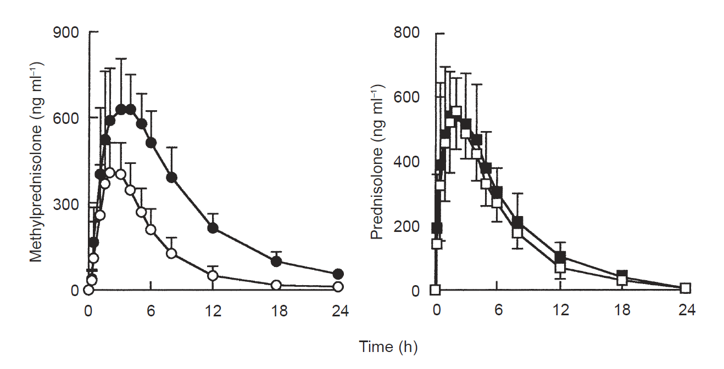
Adrenal Histoplasmosis
Itraconazole and steroids
Itraconazole increased methylprednisolone concentrations markedly with enhanced suppression of endogenous cortisol secretion, but had no effect on prednisolone pharmacokinetics.
B. Lebrun-Vignes, et al. J Clin Pharmacol, 51, 443±450.
Notes:
Mean (ts.d.) plasma concentration-time pro®les for methylprednisolone and prednisolone in 14 healthy subjects after a single
oral dose of methylprednisolone (48 mg) or prednisone (60 mg) before (O) and during () dosing with oral itraconazole (400 mg on
day 1 then 200 mg dayx1 for 3 days).

Slide 13
Adrenal Tuberculosis

Slide 14
Adrenal Tuberculosis
Organism: Mycobacterium tuberculosis
20-30% of Addison’s disease in developing world
6% of patients with active tuberculosis in an autopsy series.
M. tuberculosis disseminates to the adrenal glands hematogenously and induces degeneration of cells within adrenal cortex.
12-25% of patients have no evidence of active-extra adrenal tuberculosis.
Upadhyay J, et al. International Journal of Endocrinology. 2014;2014:7.
Paolo WF, et al. International Journal of Infectious Diseases. 2006;10(5):343-53.

Slide 15
Adrenal Tuberculosis
Clinical manifestations
Asymptomatic (for up to 10 years)
Adrenal insufficiency symptoms and signs
  More than 90% of the gland must be destroyed.
  Weakness, fatigue, anorexia, weight loss, nausea, vomiting
  Skin hyperpigmentation (60-100%)
  Hypotension
Upadhyay J, et al. International Journal of Endocrinology. 2014;2014:7.

Slide 16
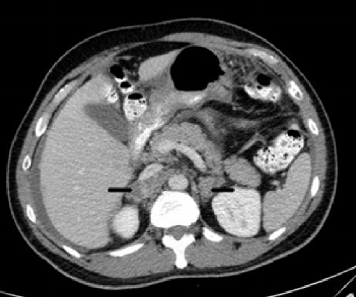
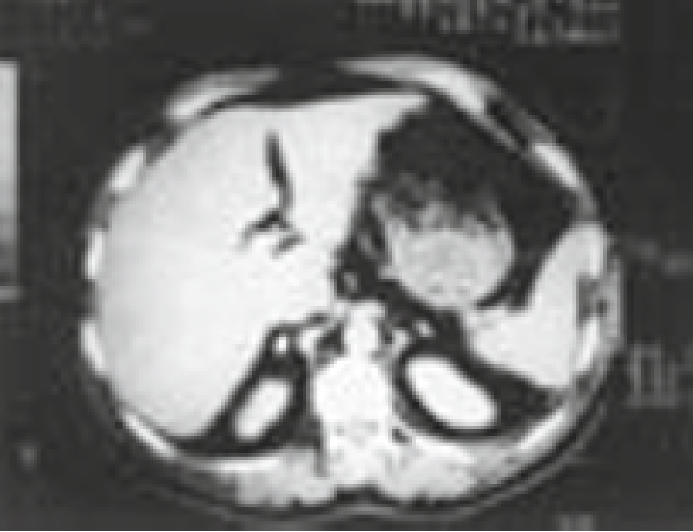
Adrenal Tuberculosis
CT scan
Active or recent infection (< 2 yr)
  Bilateral adrenal enlargement
  Small non-enhancing area – caseous necrosis
Inactive or remote infection
  Calcified or atrophy adrenal glands
F. Kelestimur. J Endocrinol Invest. 27: 380-386, 2004.
Upadhyay J, et al. International Journal of Endocrinology. 2014;2014:7.

Slide 17
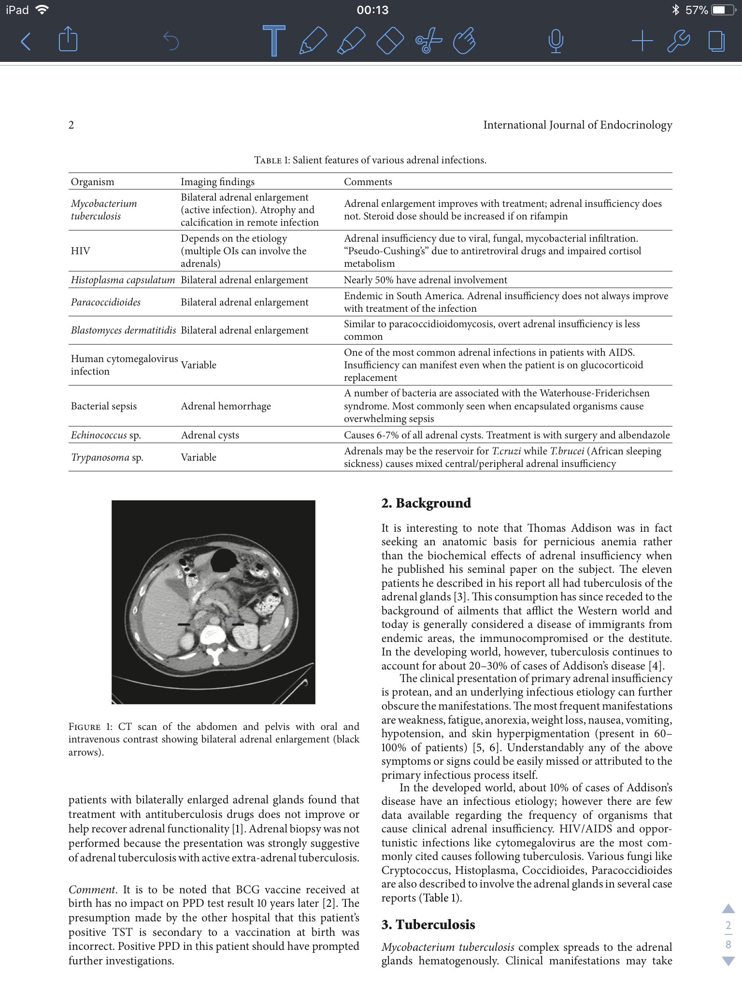
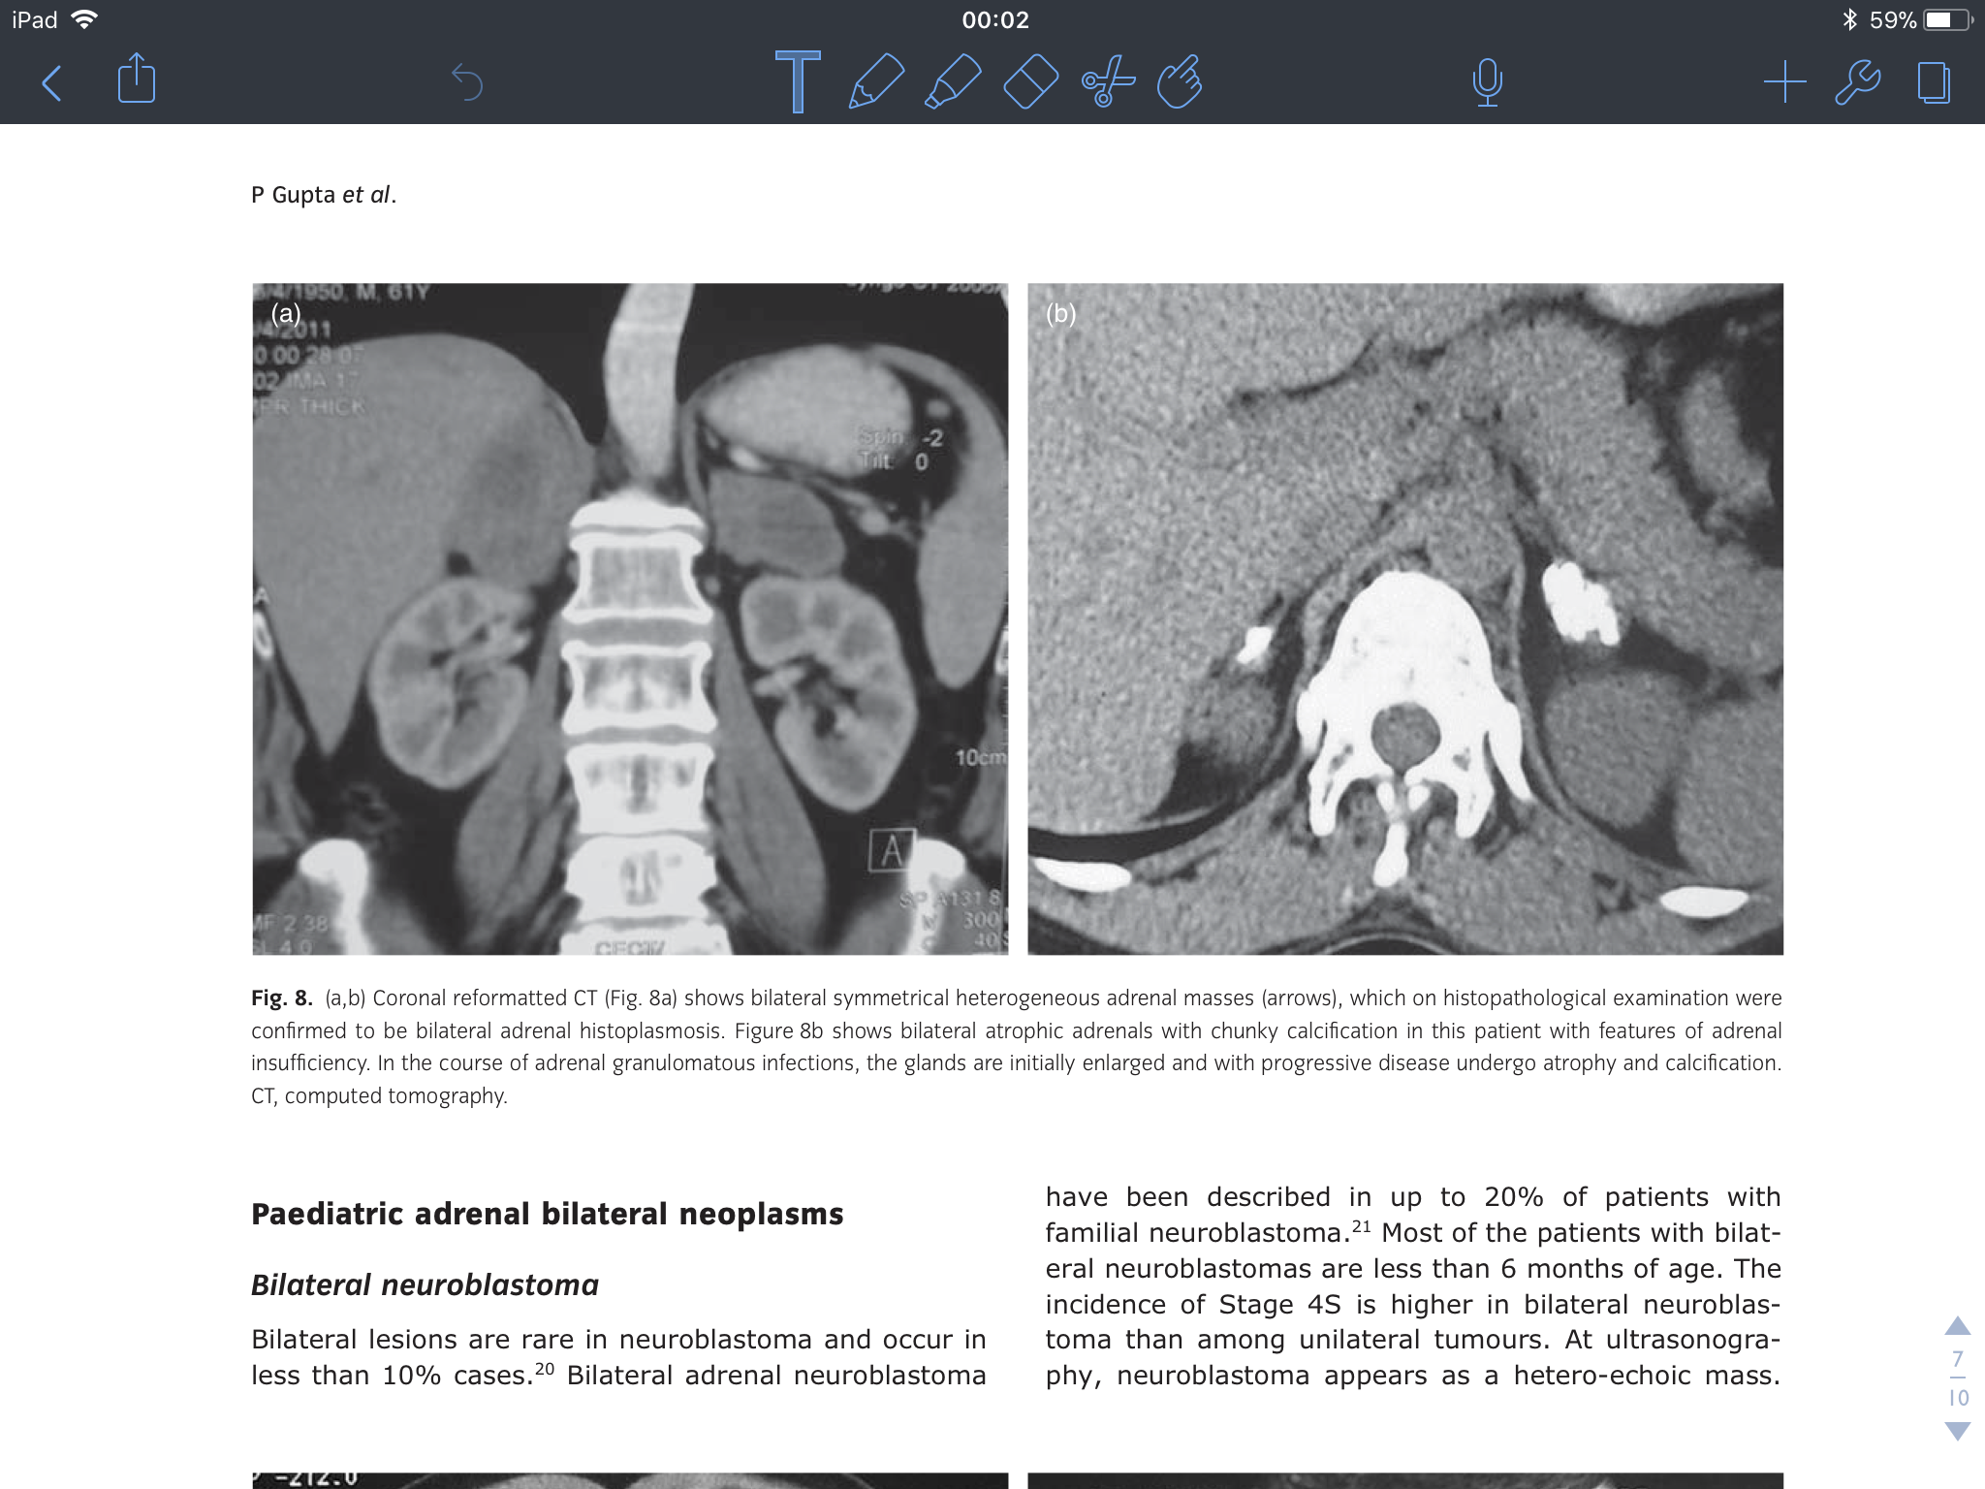
Adrenal Tuberculosis
Figure 8b shows bilateral atrophic adrenals with chunky calcification in this patient with features of adrenal insufficiency. In the course of adrenal granulomatous infections, the glands are initially enlarged and with progressive disease undergo atrophy and calcification. CT, computed tomography.
International journal of endocrinology Volume 2014,Article ID 876037
Journal of Medical Imaging and Radiation Oncology 56 (2012)

Slide 18
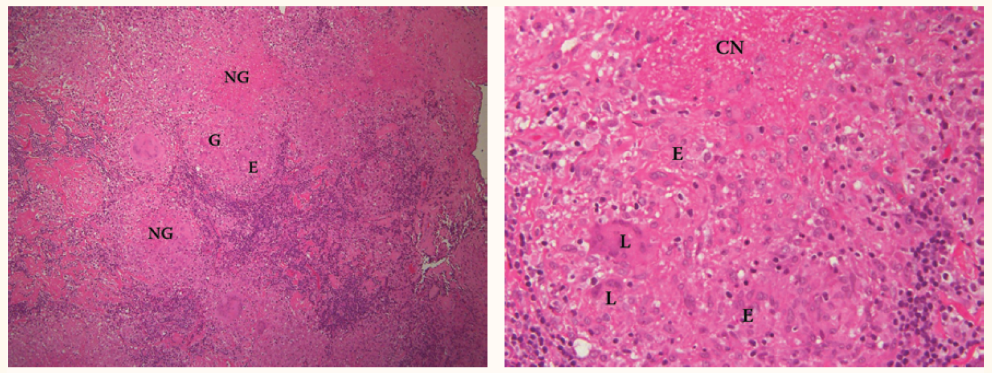
Adrenal Tuberculosis
Diagnosis
Adrenal biopsy
  Not necessary for patients with primary AI with bilateral adrenal enlargement with proven extra-adrenal tuberculosis
  Histopathology: necrotizing granuloma composed of multinucleated giant cells and epithelioid histiocytes
SQU Med J, 2009; Vol. 9, Iss. 3, pp. 324-327.
Upadhyay J, et al. International Journal of Endocrinology. 2014;2014:7.
Notes:
Left: multiple necrotising granulomas (NG) composed of multinucleated giant cells (G) and epithelial histiocytes (E).
Right: granuloma with central necrosis (CN) and composed of epithelioid histiocytes (E) and Langhans giant cells (L).

Slide 19
Adrenal Tuberculosis
ATS/CDC/IDSA Guidelines for Drug-Susceptible TB 2016¹
Disseminated tuberculosis
  A standard daily 6-month regimen is adequate for tuberculosis at multiple sites. (expert opinion)
  Concurrent corticosteroid therapy is indicated for
    Severe respiratory failure
    Adrenal insufficiency
Glucocorticoid (and mineralocorticoids) replacement²
In overt AI, anti-tuberculosis treatment does not appear to restore adrenal function.²
1. Nahid P, et al. Clinical infectious disease. 2016;63(7):e147-e95.
2. Upadhyay J, et al. International Journal of Endocrinology. 2014;2014:7.

Slide 20
Adrenal Tuberculosis
Rifampicin and adrenal insufficiency
Rifampicin is a potent inducer of the cytochrome P450IIIA enzyme.
Cytochrome P450IIIA enzyme has 6β-hydroxylase activity.
Denny N, et al. BMJ Case Rep 2016.

Slide 21
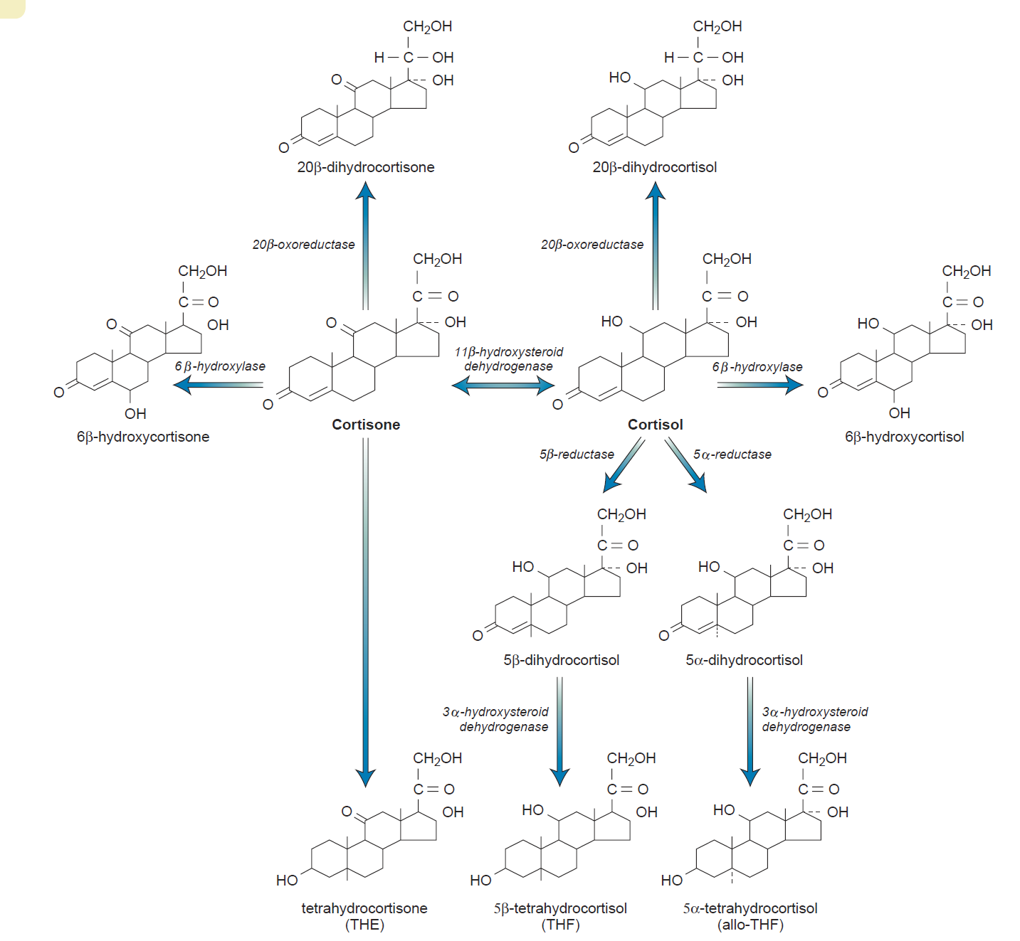
William’s Textbook of Endocrinology, 13th edition, 2016.

Slide 22
Adrenal Tuberculosis
Rifampicin and adrenal insufficiency
1.5% of patients with either pulmonary or extra-pulmonary TB treated with standard regimen developed clinical AI and required IV corticosteroids.
Dose of rifampicin: 450-600 mg
Onset: 9 days to 7 weeks after start treatment
Prevention
  An early morning cortisol is performed in all patients with active TB infection, especially those with radiological evidence of adrenal gland involvement.
  Identify patients -> close monitoring -> early corticosteroid replacement
Denny N, et al. BMJ Case Rep 2016.

Slide 23
Tuberculosis and Histoplasmosis Co-Infection

Slide 24
Persistent constitutional symptoms despite anti-tuberculous treatment in disseminated TB
Inadequate steroid replacement
  Absorption
  Drug compliance
  Drug-drug interaction: Rifampicin
Multi-drug resistant (MDR) tuberculosis
  2.4% of newly TB infection¹
  85% of patients with extra-pulmonary TB had fever resolution after initiation of anti-TB drugs for one week.²
Concomitant with other infections
Boonsarngsuk V, et al. Singapore Med J. 2009 Apr;50(4):378-84.
Hsieh SM, et al. J Formos Med Assoc. 1999 Aug;98(8):550-5.

Slide 25
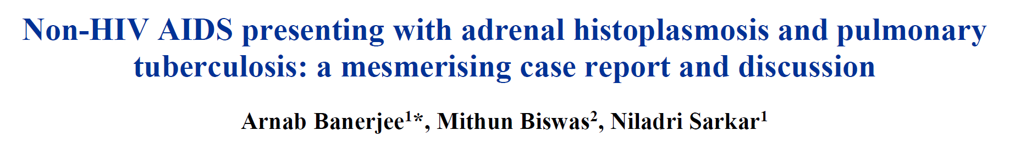
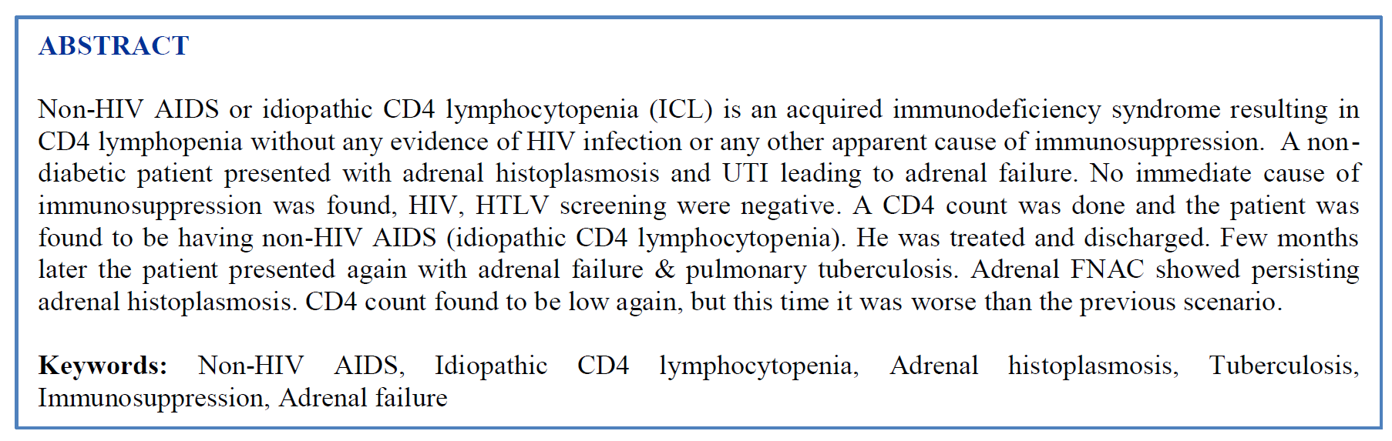
Arnab Banerjee, et al. Int J Res Med Sci. 2015 Sep;3(9):2463-2467.

Slide 26
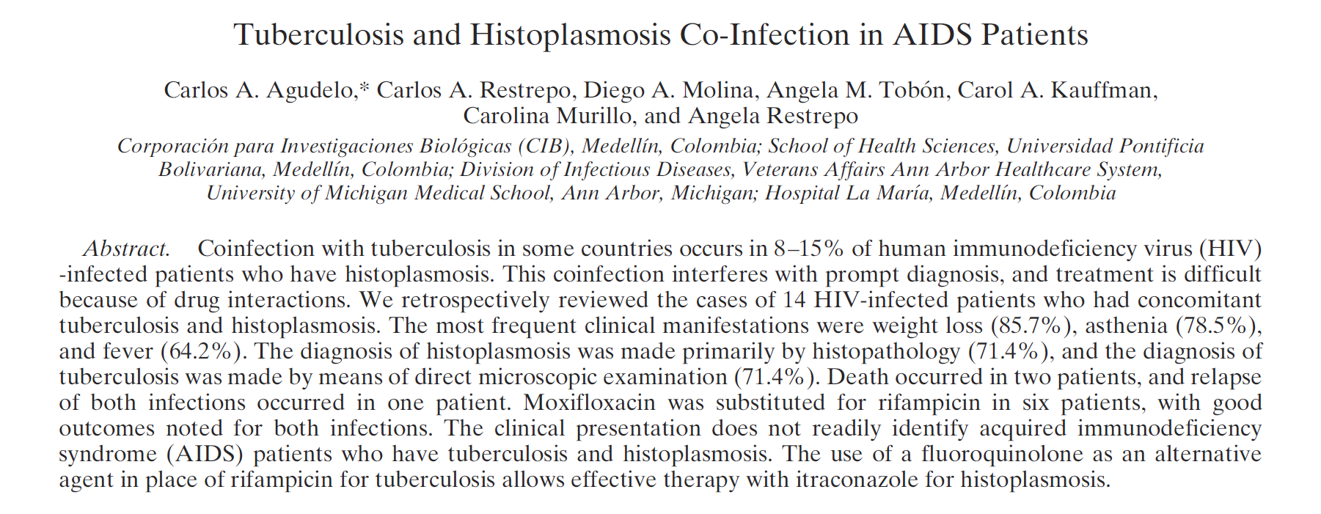
Carlos A. Agudelo, et al. Am J Trop Med Hyg. 2012; 87(6): 1094–1098.

Slide 27
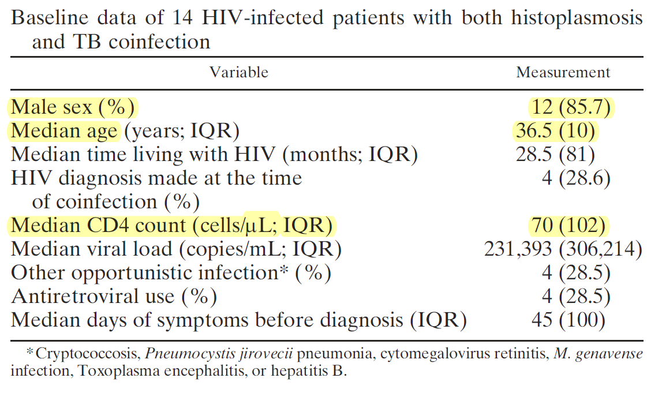
TB and Histoplasmosis co-infection in AIDS patients
Carlos A. Agudelo, et al. Am J Trop Med Hyg. 2012; 87(6): 1094–1098.

Slide 28
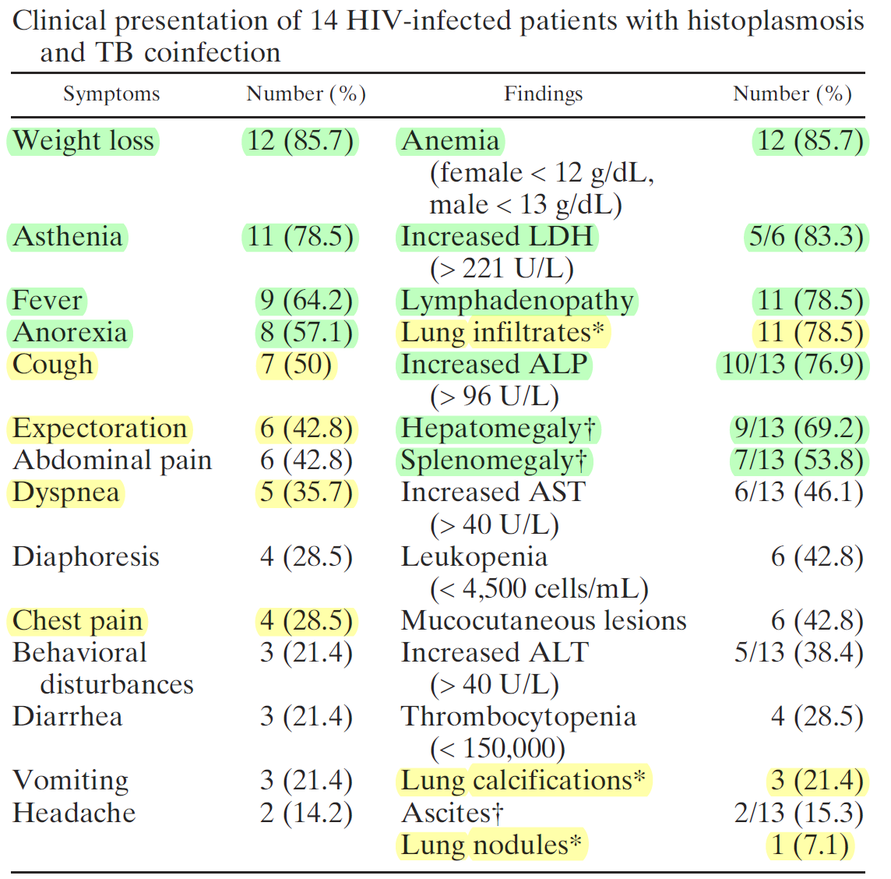
TB and Histoplasmosis co-infection in AIDS patients
Carlos A. Agudelo, et al. Am J Trop Med Hyg. 2012; 87(6): 1094–1098.

Slide 29
TB and Histoplasmosis co-infection in AIDS patients
Organ involvement in 14 patients
Histoplasmosis: n (%) | Tuberculosis: n (%)
Lung 5 (35%) | Lung 12 (85%)
Lymph node 7 (50%) | Lymph node 6 (42%)
Skin biopsy 2 (14%) | Skin biopsy 1 (7%)
GI tract 2 (14%) | GI tract biopsy 2 (14%)
Liver biopsy 2 (14%) | Liver – none
Bone marrow 1 (7%) | Bone marrow 1 (7%)
> 1 organ 5 (35%) | > 1 organ 8 (57%)
Carlos A. Agudelo, et al. Am J Trop Med Hyg. 2012; 87(6): 1094–1098.

Slide 30
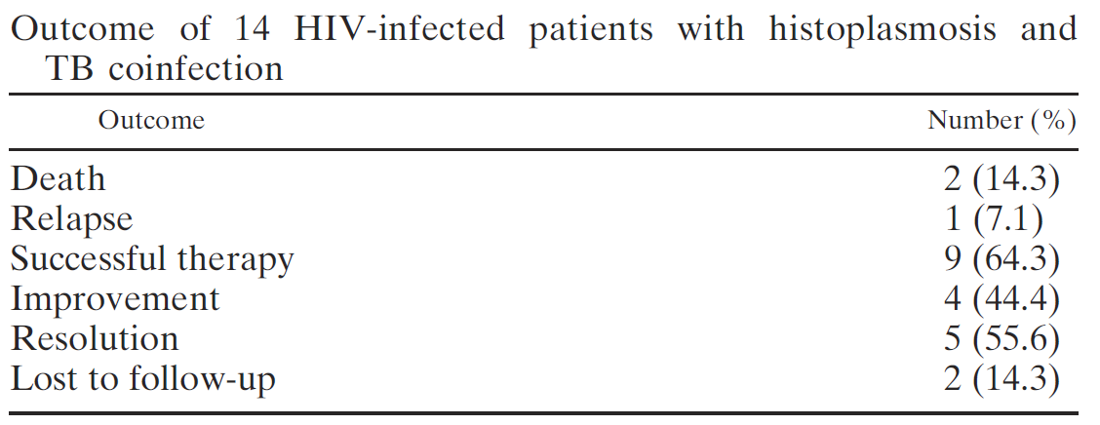
TB and Histoplasmosis co-infection in AIDS patients
Carlos A. Agudelo, et al. Am J Trop Med Hyg. 2012; 87(6): 1094–1098.

Slide 31
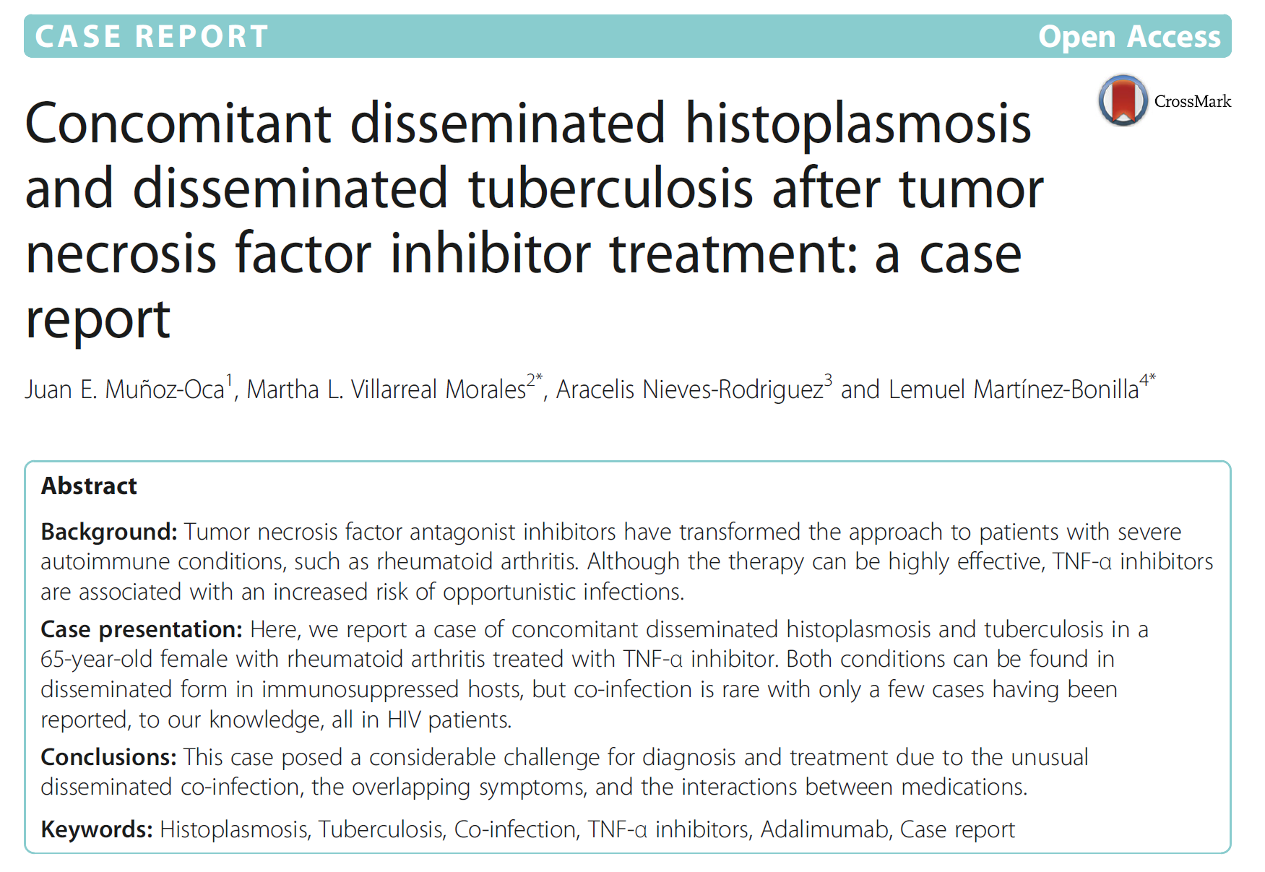
Juan E. Muñoz-Oca, et al. BMC Infectious Diseases. 2017; 17:70.

